Slide 1
Dependency Injection
Mark Pollack
SpringSource/VMware
mark.pollack@springsource.com

Slide 2
What is Dependency Injection?
An approach to application configuration
Why should you care?
Applications that use DI are more naturally ‘loosely coupled’
Loosely coupled applications
Are easier to test and maintain
Promote agile development and flexible design

Slide 3
Tight coupling in action
Presentation Layer
Component 1
Component 2
Component 4
Component 3
Component 5
Component 6
Data Access Layer

Slide 4


Slide 5
Example: Tight Coupling
public class OrderService : IOrderService {
private SqlOrderRepository orderRepository;
private SmtpNotificationService notificationService;
private int alertQuantity = 10000;
public OrderService() {
this.orderRepository = new SqlOrderRepository();
this.notificationService = new SmtpNotificationService();
}
public int AlertQuantity { set { alertQuantity = value; } }
public string CancelOrder(long orderId) {
// use orderRepository and notificationService
return guid;
}
}

Slide 6
Example: Loose coupling
public class OrderService : IOrderService {
private IOrderRepository orderRepository;
private INotificationService notificationService;
private int alertQuantity = 10000;
public OrderService(IOrderRepository orderRepository,
INotificationService notificationService) {
this.orderRepository = orderRepository;
this.notificationService = notificationService;
}
public int AlertQuantity { set { alertQuantity = value; } }
public string CancelOrder(long orderId) {
// use orderRepository and notificationService
return guid;
}
}

Slide 7
“Hand Coded DI”
public void Configure()
{
IOrderRepository repo = new SqlOrderRepository();
INotificationService smtpService =
new SmtpNotificationService();
IOrderService svc =
new OrderService(repo, smtpService);
}

Slide 8
Now you can do unit tests…
public string CancelOrder(long orderId)
{
Order order = orderRepository.FindOrder(orderId);
string confirmationId = orderRepository.CancelOrder(order);
if (order.Quantity > alertQuantity)
{
notificationService.SendCancelNotification(order);
}
return confirmationId;
}

Slide 9
Test code
[Test]
public void OrderService()
{
IOrderRepository stubRepo = new StubOrderRepository();
INotificationService stubService =
new StubNotificationService();
IOrderService svc = new OrderService(stubRepo, stubService);
string confirmationid = svc.CancelOrder(123);
Assert.IsNotNull(confirmationid);
// Assertions on INotificationService behavior
// Was it called?
}

Slide 10
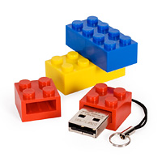
Loose Coupling
Interface-based contracts promote
loose coupling
Assemble more of your application ‘lego style’
But how?
Classes no longer manage collaborating objects
Abstract Factory design pattern
Close but no cigar…
Use a Dependency Injection container

Slide 11
Problem
The object should not be dependent on knowledge of how to create its collaborators
Problem
Hand coded factories are impractical
Solution
Separate the responsibility of creating collaborating objects to a Dependency Injection (DI) container
Context
Object needs to create and use collaborating objects
DI
Container
Component 1
S1
private Component2 c2;
public Init() {
S1 s1 = new S1(...);
S2 s2 = new S2(...);
c2 = new C2(s1,s2);
}
private Component2 c2;
public Component2 C2 {
set { . . . }
}
private Component2 c2;
public Component1
(Component2 c2){
this.c2 = c2;
}
Component2
S2
Constructor Injection
Setter Injection

Slide 12
Inversion of Control
Release control of some logic to a framework
Event-Driven Architecture
Framework polls or listens to an event source
Framework notifies or invokes a service
Dependency Injection Container
Container is creating classes, setting properties
Container may ‘wrap’ objects with other services

Slide 13
Containers are not new
MTS
COM+ / Enterprise Services
Server.CreateObject(“Database.Connection”)
But were ‘heavyweight’
Inherit from ‘magic’ base class or interface
Dependency Injection Containers
Are ‘Lightweight’ but provide same many benefits

Slide 14
Dependency Injection Containers
Promote a component model that actually works
Non-invasive
POCOs not tied to the DI container
Beware of DI container attributes!
PLAIN OLD CLR OBJECTS (POCO)

Slide 15
What is the downside to DI?
One more thing to learn…
It is worth the effort
A few books, but mostly online resources.
Another level of abstraction
Need to select a DI container

Slide 16
Where can I get one of these…
Autofac
Castle Windsor
NInject
Spring for .NET
StuctureMap
Unity

Slide 17
The 1st order summary…
All provide similar DI functionality
Try not to think of DI ‘having an API’
Differences are how you configure the container to create objects and assemble your application
Different extensibility models
Some offer additional capabilities
AOP, Transaction Management,
Support for several runtime environments
ASP.NET WebForms/MVC, WCF, …

Slide 18
The quick guide to using a DI container
Configure a DI container’s object creation and configuration rules via
XML
Configuration API
Attributes

Slide 19
Classes used in the example
public class ConsoleReport {
// private fields omitted
public ConsoleReport(IOutputFormatter outputFormatter,
IPrimeGenerator primeGenerator) {
_outputFormatter = outputFormatter;
_primeGenerator = primeGenerator;
}
public int MaxNumber {
get { return _maxNumber; }
set { _maxNumber = value; }
}
}

Slide 20
Classes used in the example
static void Main(string[] args) { ConsoleReport report = new ConsoleReport( new OutputFormatter(),
new PrimeGenerator(new PrimeEvaluationEngine())
); report.MaxNumber = 1000; report.Write(); Console.WriteLine("--- hit enter to exit --"); Console.ReadLine(); }

Slide 21
Creating the Unity Container
class Program
{
static void Main(string[] args)
{
using (var container = new UnityContainer())
{
//configure container
//ask container for objects (configured) and use them
}
}
}

Slide 22
Configuring the Unity Container
class Program
{
static void Main(string[] args)
{
using (var container = new UnityContainer())
{
//configure container
container
.RegisterType<IOutputFormatter, OutputFormatter>()
.RegisterType<IPrimeGenerator, PrimeGenerator>();
//ask container for objects (configured) and use them
}
}
}

Slide 23
Getting Configured Objects
class Program {
static void Main(string[] args) {
using (var container = new UnityContainer()){
//configure container
container
.RegisterType<IOutputFormatter, OutputFormatter>()
.RegisterType<IPrimeGenerator, PrimeGenerator>();
//ask container for objects (configured) and use them
var report = container.Resolve<ConsoleReport>();
report.Write();
}
}
}

Slide 24
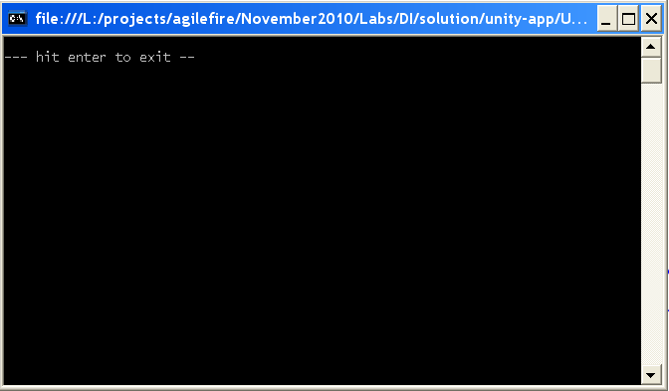
However…
Runs but no output ☹
Default max number is set to 0
Only configured relationships between object types
‘Type Mapping’
But simple properties need to be set as well

Slide 25
Configuring Simple Properties
class Program {
static void Main(string[] args) {
using (var container = new UnityContainer()) {
//configure container
container
.RegisterType<IOutputFormatter, OutputFormatter>()
.RegisterType<IPrimeGenerator, PrimeGenerator>();
container.Configure<InjectedMembers>()
.ConfigureInjectionFor<ConsoleReport>(
new InjectionProperty(“MaxNumber”, 1000)
);
//ask container for objects (configured) and use them
var report = container.Resolve<ConsoleReport>();
report.Write();
}
}
}

Slide 26
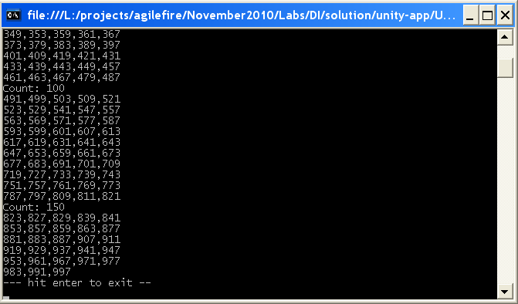
Now we get our prime numbers…

Slide 27
Object Lifecycle
What happens if you call
container.Resolve<ConsoleReport>();
Twice…?
Container has options to control the lifecycle
Transient/“Prototype” – new one each time
The default option
Singleton – one for the life of the container
ContainerControlledLifetimeManager
Externally Controlled – one for the life of the container
But container holds a weak reference to the object
ExternallyControlledLifetimeManager
LifetimeManager base class to customize

Slide 28
Now as singletons…
class Program {
static void Main(string[] args) {
using (var container = new UnityContainer())
{
//configure container
container
.RegisterType<IOutputFormatter, OutputFormatter>(new
ContainerControlledLifetimeManager())
.RegisterType<IPrimeGenerator, PrimeGenerator>(new
ContainerControlledLifetimeManager())
.RegisterType<ConsoleReport>(new ContainerControlledLifetimeManager());
container.Configure<InjectedMembers>()
.ConfigureInjectionFor<ConsoleReport>(
new InjectionProperty("MaxNumber”, 1000)
);
//ask container for objects (configured) and use them
var report = container.Resolve<ConsoleReport>();
report.Write();
}
}
}
Transient when calling .RegisterType
Use ContainerControlledLifetimeManager to have singleton behavior

Slide 29
Setter Dependency Injection
class Program {
static void Main(string[] args) {
using (var container = new UnityContainer()) {
//configure container
container
.RegisterType<IOutputFormatter, OutputFormatter>()
.RegisterType<IEmailService, EmailService>()
.RegisterType<IPrimeGenerator, PrimeGenerator>();
container.Configure<InjectedMembers>()
.ConfigureInjectionFor<ConsoleReport>(
new InjectionProperty(“EmailService”,
new ResolvedParameter<IEmailService>())
);
//ask container for objects (configured) and use them
var report = container.Resolve<ConsoleReport>();
report.Write();
}
}
}

Slide 30
Setter Dependency Injection (II)
public class ConsoleReport
{
private IEmailService _emailService;
private IOutputFormatter _outputFormatter;
private IPrimeGenerator _primeGenerator;
public ConsoleReport(IOutputFormatter outputFormatter,
IPrimeGenerator primeGenerator)
{
_outputFormatter = outputFormatter;
_primeGenerator = primeGenerator;
}
[Dependency]
public IEmailService EmailService
{
set { _emailService = value; }
}
}
No longer a POCO

Slide 31
Unity XML Configuration Outline
<configuration>
<configSections>
<section name="unity" type=“...”/>
</configSections>
<unity>
<typeAliases>
<!-- register alias to reduce verbosity -->
</typeAliases>
<containers>
<container>
<types>
<type type="Primes.ConsoleReport, Primes">
<lifetime type="singleton" />
<typeConfig extensionType=“…”>
<!– configure constructor and properties -->
</typeConfig>
</type>
<!– repeat for more more type configurations -->
</types>
</container>
</containers>
</unity>

Slide 32
Unity XML Configuration - I
<?xml version="1.0" encoding="utf-8" ?>
<configuration>
<configSections>
<section name="unity" type="Microsoft.Practices.Unity.Configuration.UnityConfigurationSection, Microsoft.Practices.Unity.Configuration"/>
</configSections>
<unity>
<typeAliases>
<!-- register alieas to reduce verbosity -->
<typeAlias alias="singleton"
type="Microsoft.Practices.Unity.ContainerControlledLifetimeManager, Microsoft.Practices.Unity" />
<typeAlias alias="IOutputFormatter"
type="Primes.IOutputFormatter, Primes" />
<typeAlias alias="IPrimeGenerator"
type="Primes.IPrimeGenerator, Primes" />
</typeAliases>

Slide 33
Unity XML Configuration - II
<containers>
<container>
<types>
<type type="Primes.ConsoleReport, Primes">
<typeConfig extensionType="Microsoft.Practices.Unity.Configuration.TypeInjectionElement, Microsoft.Practices.Unity.Configuration">
<constructor>
<param name="outputFormatter" parameterType="IOutputFormatter"/>
<param name="primeGenerator" parameterType="IPrimeGenerator"/>
</constructor>
<property name="MaxNumber" propertyType="System.Int32, mscorlib">
<value value="1000" type="System.Int32"/>
</property>
</typeConfig>
</type>
<type type="IOutputFormatter" mapTo="Primes.OutputFormatter, Primes">
<lifetime type="singleton" />
</type>

Slide 34
Unity XML Configuration - III
<type type="IPrimeGenerator" mapTo="Primes.PrimeGenerator, Primes">
<lifetime type="singleton"/>
<typeConfig extensionType="Microsoft.Practices.Unity.Configuration.TypeInjectionElement, Microsoft.Practices.Unity.Configuration">
<constructor>
<param name="primeEvaluationEngine" parameterType="Primes.PrimeEvaluationEngine, Primes"/>
</constructor>
</typeConfig>
</type>
<type type="Primes.PrimeEvaluationEngine, Primes"/>
</types>
</container>
</containers>
</unity>
</configuration>

Slide 35
Spring.NET Code Configuration (see http://www.springframework.net/codeconfig
[Configuration]
public class PrimesConfiguration {
[Definition]
public virtual ConsoleReport ConsoleReport() {
return new ConsoleReport(OutputFormatter(), PrimeGenerator())
{MaxNumber = 1000};
}
[Definition]
public virtual IOutputFormatter OutputFormatter() {
return new OutputFormatter();
}
[Definition]
public virtual IPrimeGenerator PrimeGenerator() {
return new PrimeGenerator(new PrimeEvaluationEngine());
}
}

Slide 36
Creating and Configuring Spring.NET Container using Code Config
class Program
{
static void Main(string[] args)
{
using (var container = new ScanningApplicationContext())
{
//scan over all .dll/.exe to find object definitions
container.ScanAllAssemblies();
//initialize object definitions
container.Refresh();
//ask container for objects (configured) and use them
var report = container.GetObject<ConsoleReport>();
report.Write();
}
}
}

Slide 37
Creating and Configuring Spring.NET Container using XML object definitions
class Program
{
static void Main(string[] args)
{
using (var container = new XmlApplicationContext(“context.xml”))
{
//ask container for objects (configured) and use them
var report = container["ConsoleReport"] as ConsoleReport;
report.Write();
}
}
}

Slide 38
Spring.NET XML Configuration
<objects xmlns="http://www.springframework.net"
default-autowire="autodetect">
<object name="ConsoleReport" type="Primes.ConsoleReport, Primes">
<property name="MaxNumber" value="1000"/>
</object>
<object type="Primes.PrimeGenerator, Primes"/>
<object type="Primes.OutputFormatter, Primes"/>
<object type="Primes.PrimeEvaluationEngine, Primes"/>
</objects>

Slide 39
Spring.NET XML Configuration Explicit Wiring
<objects xmlns="http://www.springframework.net">
<object name="ConsoleReport" type="Primes.ConsoleReport, Primes">
<constructor-arg ref="PrimeGenerator"/>
<constructor-arg ref="OutputFormatter"/>
<property name="MaxNumber" value="1000"/>
</object>
<object name="PrimeGenerator" type="Primes.PrimeGenerator, Primes">
<constructor-arg>
<object type="Primes.PrimeEvaluationEngine, Primes"/>
</constructor-arg>
</object>
<object name="OutputFormatter" type="Primes.OutputFormatter, Primes"/>
</objects>

Slide 40
Dependency Injection Summary
Benefits
Code easier to test and maintain
Promotes loose coupling between
Classes
“Modules”/Subsystems
Will see signs of
Reuse
Better code – ‘harder to do bad things’
Drawbacks
Another level of abstraction
Need to learn a DI container technology

Slide 41
Dependency Injection LAB
Insert Tab A into Slot B…

Slide 42
Lab Exercise
Configure the Prime Number application using
Unity
Fluent API
XML
Spring.NET
XML
C#
Following instructions in docs…

